Slide 1
Principles of Microeconomics
Lecture 2
This lecture covers:
  Factors of Production
  Fundamental Economic Questions
  Economic Systems
  Economic Flow Chart
DR. DOWLAH/SPRING2016

Slide 2

Economics is the study of choice under conditions of scarcity. It’s a field of knowledge that helps in efficient utilization of scarce resources.
Resources are scarce—always and everywhere.
  Households are constrained by limited incomes,
  Business firms are constrained by requirements that they pay for all the inputs they use, and
  government agencies are constrained by limited budgets.
DR. DOWLAH/SPRING2016

Slide 3

All resources that can be used for production belong to the following four categories:
A. Land—Gifts of Nature. Income of land is known as Rent.
B. Labor—Human Contribution to Production Process. Income labor is known as Wages.
C. Capital—Machinery, equipment, plants. Income of capital is known as Interest.
D. Entrepreneurs—those people who put together the factors of production and take risk. Income of entrepreneurs is known as Capital. .
DR. DOWLAH/SPRING2016

Slide 4
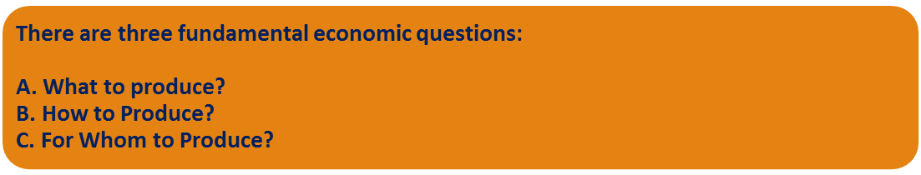
Answers to each of these fundamental questions depend on the economic system that a country adopts.
DR. DOWLAH/SPRING2016

Slide 5
What to produce?
It’s a question of Allocation of Resources—where the resources of a country will go. At the national level the decision is made by the President and Congress. At business level, what to produce is decided on the basis of Profitability.
DR. DOWLAH/SPRING2016

Slide 6

It’s a question of production—what technology to be used for production?
Technology can be labor-intensive or capital intensive.
A business chooses a technology that helps minimize its costs and maximize its profits.
DR. DOWLAH/SPRING2016

Slide 7

This is a question of Distribution of Income—who gets what?
Some economic systems produce for all—irrespective of who can pay or not.
Some economic systems produce for those who can pay.
DR. DOWLAH/SPRING2016

Slide 8

DR. DOWLAH/SPRING2016

Slide 9
How an economy is organized—Ownership of Resources?
Overwhelming private ownership –market economy--Capitalism
Overwhelming state/government ownership—socialism
Mixed system—both market and state are dominant in the economy
DR. DOWLAH/SPRING2016

Slide 10
How an economy Operates?
Through price system or through state-control?
Price system—market economy/Capitalism
State-control—Socialism
Mixed system—both Price and State are dominant.
DR. DOWLAH/SPRING2016

Slide 11

A. Capitalism—Market-oriented economies. Examples include developed economies.
B. Socialism—State-dominated economies. Not many countries are socialist now—there are, however, some examples.
C. Mixed Systems –where market and state both are dominant. Most of the developing countries belong to this category.
DR. DOWLAH/SPRING2016

Slide 12

D. Transitional Systems—These are formerly socialist economies, now moving away from socialism. Examples include former Soviet Republics and Eastern European Countries.
E. Scandinavian Systems— These are highly developed economies of Northern Europe which maintain very strong welfare systems.
DR. DOWLAH/SPRING2016

Slide 13

DR. DOWLAH/SPRING2016

Slide 14

The Circular-flow Chart is a visual model of the economy that shows how dollars flow through markets, households and firms. In other words, it shows how money makes economic transactions possible.
DR. DOWLAH/SPRING2016

Slide 15

We start with a simple economy with two sectors.
A. Firms (institutions that organize production )
  They produce and sell goods and services
  They hire and use factors of production
B. Households (individuals living together)
  They buy and consume goods and services
  They own and sell factors of production
DR. DOWLAH/SPRING2016
Notes:
7

Slide 16

A household is a housing unit occupied by one or more people.
There are about 112 million households in the United States.
About 48 percent of all households in the US are husband-wife households with or without children.
About 37 percent households are single households.
DR. DOWLAH/SPRING2016

Slide 17

There are approximately 20 million firms/businesses in the United States. The three major legal forms of businesses in the United States are:
  Partnerships (more than one owner),
  Sole Proprietorships (one owner),
  Corporations (owned by shareholders).
DR. DOWLAH/SPRING2016

Slide 18

Among the firms, about 72% are sole proprietorships and 20% are corporations, but corporations account for 84% of total sales revenues in the United States.
Virtually all the nation’s largest business enterprises are corporations. Partnerships account for 11% of national output, while sole proprietorships account for only 5% .
DR. DOWLAH/SPRING2016

Slide 19
Revenue
MARKETS
Spending
FOR
Goods
GOODS AND SERVICES
Goods and
and services
Firms sell
services
sold
Households buy
bought
FIRMS
HOUSEHOLDS
Produce and sell
Buy and consume
goods and services
goods and services
Hire and use factors
Own and sell factors
of production
of production
Factors of
MARKETS
Labor, land,
production
FOR
and capital
FACTORS OF PRODUCTION
Wages, rent,
Households sell
Income
and profit
Firms buy
= Flow of inputs
and outputs
= Flow of dollars
DR. DOWLAH/SPRING2016

Slide 20

A more complex Circular Flow Chart includes three other sectors in the economy.
The Financial Sector
The Government and
The International Sector
DR. DOWLAH/SPRING2016

Slide 21
Financial Sector
The Financial sector is at the center of an economy. This sector consists of:
A. Financial intermediaries—such as banks, insurance and investing companies—which channel households’ savings into loans for business investment.
B. Capital Market--in which households supply their savings, for interest or for claims to future profits, to firms that demand funds to buy capital goods.
DR. DOWLAH/SPRING2016

Slide 22

Economic Functions of the government include:
A. Regulation of economy;
B. Maintenance of law and order;
C. Providing infrastructures and public goods, and
D. Taking care of externalities.
DR. DOWLAH/SPRING2016

Slide 23

Externality refers to a cost or benefit to a third party not involved in an economic transaction.
There are two-types of externalities: Positive Externality and Negative Externality.
        Economic actions like smoking and pollution cause negative externality—government discourages such activities by penalizing them.
        On the other hand, education and healthcare create positive externalities, most governments encourage such activities
DR. DOWLAH/SPRING2016

Slide 24

The Government’s main source of revenue comes from taxation. Major Taxes in the United States are:
A. Income Tax (main source of revenue for Federal Government)
B. Sales Tax (main source of revenue for state Governments)
C. Property Tax (main source of revenue for local governments).
Principles of Taxation applied to these taxes are different.
DR. DOWLAH/SPRING2016

Slide 25

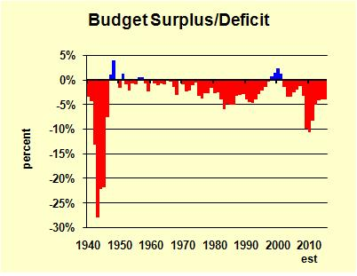
Government’s budget may be balanced when government revenues equal government expenditures .
Deficit Budget—when government expenditures exceed government revenues.
Surplus Budget—when government revenues exceed government expenditures.
DR. DOWLAH/SPRING2016

Slide 26

When a country sells goods to other countries, it is called exports. When a country buys goods from other countries, it is called imports.
Balanced Trade—when exports and imports are equal.
Trade Surplus—when exports exceed imports.
Trade Deficit—when imports exceed exports.
DR. DOWLAH/SPRING2016

Slide 27

When American dollar appreciates, it is likely that US exports would fall and imports would rise. (Strong dollar effect).
When American dollar depreciates, it is likely that US imports would fall and exports would rise. (Weak dollar effect)
DR. DOWLAH/SPRING2016

Slide 28

American government has been running budget deficits for a long time, except couple of years during Bill Clinton period. When government runs deficits, it has to borrow money.
National debt is accumulation of all these borrowings—all these annual budget deficits.
DR. DOWLAH/SPRING2016

Slide 29
The US National Debt stood at $19.5 trillion as of Sept. 7, 2016.
Each citizen's share of the debt is estimated to be $60,184
Each Taxpayer’s share is estimated at $163,071.
The National Debt has been increasing an average of $2.38 billion per day.
DR. DOWLAH/SPRING2016

